Slide 1
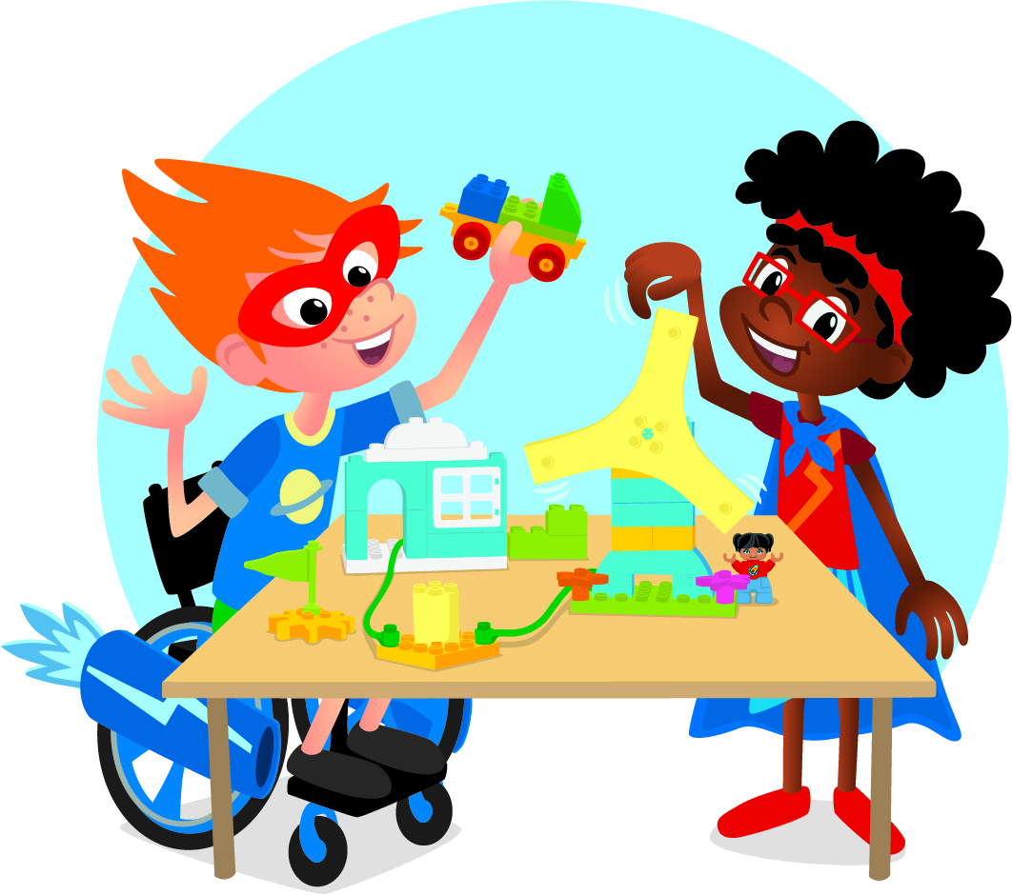


INTRODUCTION
Let’s Get Started

Slide 2

What is FIRST® LEGO® League Discover?
Notes:
A new version of this video will be provided after season launch. Watch directly on YouTube here: https://youtu.be/Ar1rNLPHekA

Slide 3

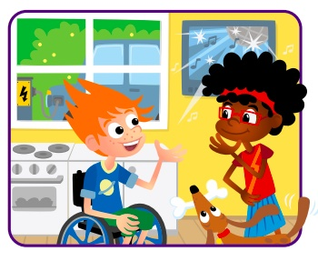
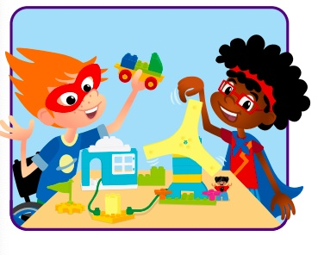
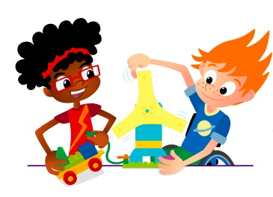
Let’s discover where you get energy.
Now, explore how you use energy.
Then, create your community’s energy story.
Finally, share what you have
learned and celebrate with
others.

Slide 4
Each Session has…
Big question
Six Bricks Warm-Up
Task 1 – Explore
Task 2 – Create
Task 3 – Share with your classmates or in your Engineering Notebook
Clean Up
Notes:
Big question: Each session has a Big Question that can be shared to frame the session.​
Six Bricks Warm-Up: Every session has a short warm-up activity using the six bricks sets.
Task 1 – Explore: The sessions start with a task to help students learn about the topic.
Task 2 – Create: Students will create builds during each session.
Task 3 – Share with your classmates or in your Engineering Notebook: Students share their work by either showing and explaining their builds or completing a task in their Engineering Notebook.
Clean Up: Take time during each session to have the students clean up and put away the materials.

Slide 5
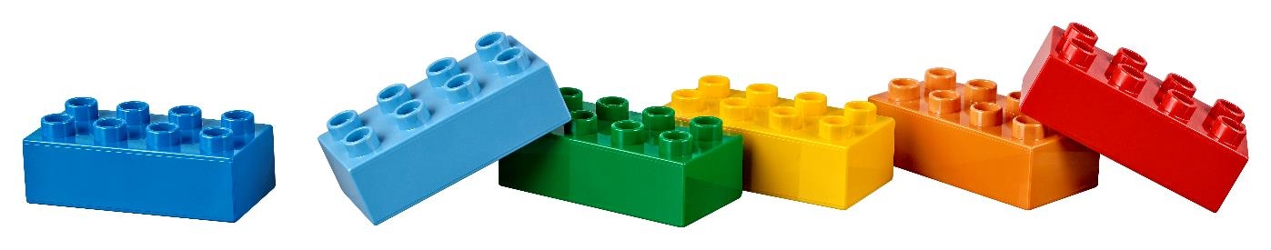
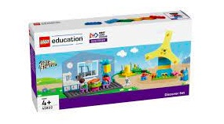
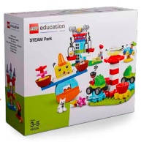
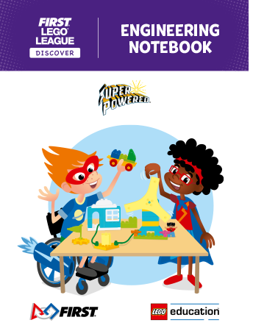
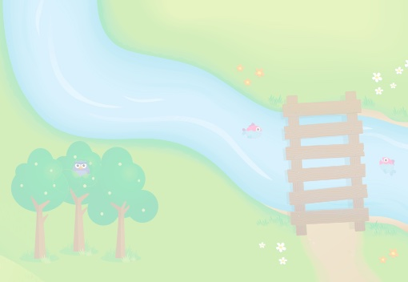
You will use…
Six Bricks
Discover Set
Engineering
Notebook
Discover Mat
STEAM Park Set
Notes:
Discover Set with Mat and Six Bricks
The Discover set consists of the SUPERPOWEREDSM Discover model (wind turbine, kitchen, energy station, powerlines), LEGO® DUPLO® figures, Six Bricks sets, mat, and building cards. The Discover model is intended to help children connect to the theme and provide a starting point for discussions and further building. The mat is used as a collaboration space to bring the models together. Each Discover set includes five sets of Six Bricks for use in the classroom. There are enough sets to give one to each child, plus one for the teacher. Each child will need one of each of the six colored bricks. The Six Bricks in this set are in addition to the Six Bricks in the Discover More set that goes home.
Engineering Notebook
You will receive a set of SUPERPOWEREDSM Engineering Notebooks, which provide a place for children to record their ideas and sketches as they progress through their journey. There is one page to fill in for every other session. Provide one notebook to each child.
LEGO® Education STEAM Park Set
Each team should have access to pieces from the STEAM Park set. All teams will use the STEAM Park set to explore STEM concepts and form the basis of their team model. There will also be problems throughout the sessions, as well as at the celebration event, that can be explored and solved using the set’s many colorful, easy-to-operate functional pieces. The STEAM Park Teacher Guide can be found on the LEGO® Education website, alongside other ideas and inspiration.
https://education.lego.com/en-us/product-resources/steam-park/teacher-resources/teacher-guide-pdfs
The teacher guide introduces the set, as well as learning grids and additional activities. We suggest pre-teaching the following sessions from the teacher guide if class is new or students are new to STEAM Park:
1. Functional Elements
2. Welcome to STEAM Park
3. Gears

Slide 6

SUPERPOWEREDSM
Visit the
FIRST® LEGO ® League
YouTube Channel
to watch the
SUPERPOWEREDSM Season Launch Video

Slide 7


LEGO, the LEGO logo, DUPLO and the DUPLO logo are trademarks of the/sont des marques de commerce du/ son marcas registradas de LEGO Group. ©2022 The LEGO Group. All rights reserved/ Tous droits réservés/ Todos los derechos reservados. FIRST®, the FIRST® logo, and FIRST ENERGIZESM are trademarks of For Inspiration and Recognition of Science and Technology (FIRST). LEGO® is a registered trademark of the LEGO Group. FIRST® LEGO® League and SUPERPOWEREDSM are jointly held trademarks of FIRST and the LEGO Group. ©2022 FIRST and the LEGO Group. All rights reserved.

